Slide 1
Benefits 2023
STOUGHTON Health’s Virtual Benefits Fair

Slide 2
Which Best Describes Your Insurance Needs?
Single
Employee Plus Spouse
Family
Employee Plus Children

Slide 3
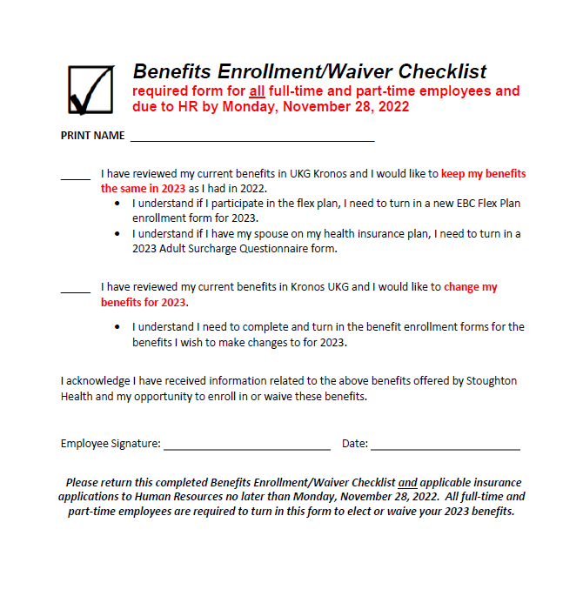
Important 2023 Benefit Information
Use this Form as a Checklist to Guide You Through What is Required AND Return Completed Form to Human Resources by Monday, November 28th:

Slide 4
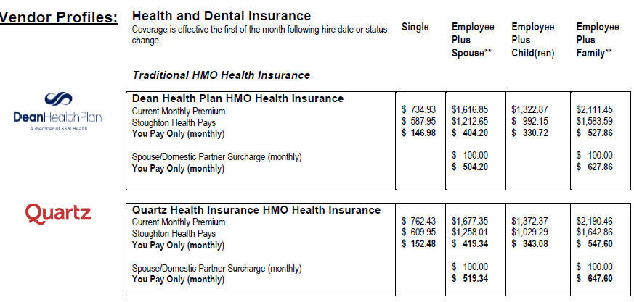
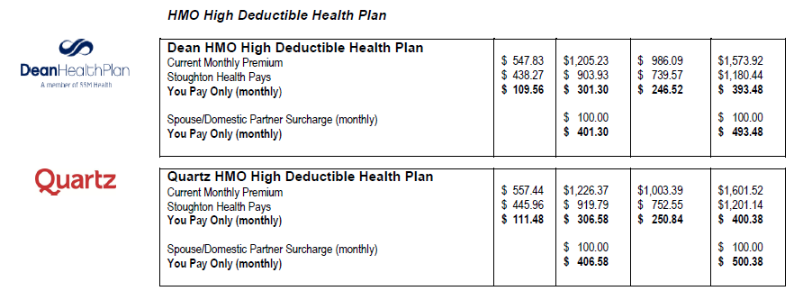
Open Enrollment AND Dual Choice Available for Health Insurance:
Traditional HMO Plan
or High Deductible Health Plan HMO
Full-Time Employees
Full-Time Employees

Slide 5
Open Enrollment Available for:
Health Savings Account (for High Deductible Health Plan)
Flex Plan – Medical, Limited, and Dependent Care
Dental Insurance for Dependents

Slide 6
Qualifying Event Enrollment Available for:
Dental Insurance for Employees

Slide 7
Potential Coverage Increase Available for:
Voluntary Life Insurance for an Increase of $10,000 Coverage

Slide 8
Forms due to Human Resources Due by Monday, November 28th
Forms Due | Condition
Benefits Enrollment/Waiver Checklist (2023) | Due from ALL Benefit Eligible Employees
Adult Surcharge Questionnaire (2023) | Due from ALL Employees WITH a Spouse or Domestic Partner on SH Plan to Waive Adult Surcharge
Flex Plan or Limited Flex Plan Enrollment Form (EBC) | Return Forms IF You Wish to Participate in 2023
Health Insurance Forms (Dean and Quartz) | Return Forms IF You Wish to Make ANY Changes
Health Savings Account Enrollment Form (EBC) | Return Forms IF You Wish to Participate in 2023
Dental Insurance Form (Delta) | Due To Add or Drop of Coverage. Must Return BOTH Qualifying Event Form AND Insurance Forms
Affidavit of Tax Status of Benefits for Domestic Partner and Children (2023) | Due from ALL Employees with a Domestic Partner on Either Health or Dental plans
Voluntary Life Insurance (MoO) | Current Participants May be able to Buy-up in Coverage
Retirement Enrollment and Designation of Beneficiary Form (403b) | Enroll Anytime. Pre-Tax or Roth. 4% Employer Match

Slide 9
Benefits Enrollment/Waiver Checklist Minimum Form Due Each Year
Return Completed Form to Human Resources by Monday, November 28th:

Slide 10
VIEW AND ACCESS ALL ENROLLMENT FORMS AT: www.stoughtonhealth.com/benefits-fair/

Slide 11
Thank You for your time! Contact Human Resources with questions.

